Slide 1
Transportation &
Logistics Systems
Session 2
Inventory Management - II
January 15, 2019

Slide 2
Announcements
HW 1 due now
HW 2 due next week
  Doable after today’s class
HW 3 and 4 are teamwork (case write-up)
  Cases discussed after respective HW is turned in
What is a good start date for take-home final exam?
  You will have one week to work on it
  Check your schedules, will ask next week

Slide 3
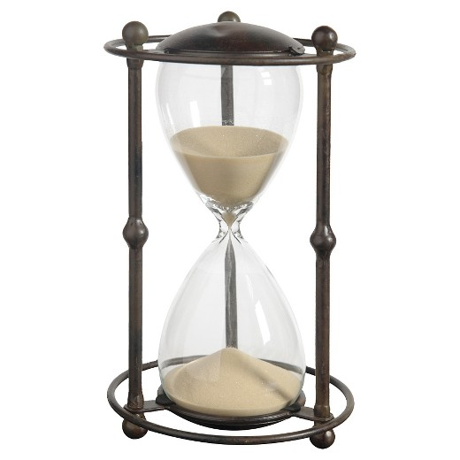
Lecture Outline
Case: Sport Obermeyer
Classifying Inventory Models
Inventory Models: The Details
Summary

Slide 4



Notes:
42

Slide 5

Company Overview
History
- Found in 1947
- Introduced German ski clothing
Products
- A broad line of fashion ski apparel
- Functionality and style
- Seasonal sales
- Short product life
Position in Market
- Target middle to high-end market
- Excellent balance in price and value
- Market share: 45% in children skiwear, 11% in adults
Notes:
History
-Found in 1947
-Introduced superior German ski clothing to US
Durable, high-performance
Products
- A broad line of fashion ski apparel
parkas, vests, ski suites, accessories
parkas are the most important of a collection, others are designed to match parkas
- functionality and style
functionality - important worn when skiing, warm, water-proof, flexible
Style – requires variety, quick response to preference, obsolesce
- 10 styles represent 10% of demand
- Seasonable sales
between September and January, peak in Dec. and Jan
- One per customer in one season
SO’s Position in Market
- Target middle to high-end market
- Excellent in Price vs. value balance
- 10 styles represent 10% of demand
- Market share 45% in children’s skiwear 11% in adult’s (1992)

Slide 6
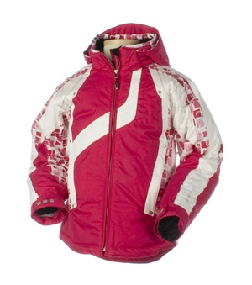
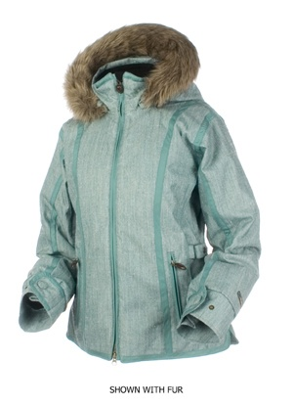
Time Line
First
Production
order
Second
Production
order
Deliver
To
Stores
Final
Design
Feb 92
Oct 92
Nov 92
Mar 93
Aug 93
Design
Sample production
Procurement
First production
Procurement
Second production
Sales Season
1993-94
Stain Removal Tip from SO homepage!
COSMETICS - Apply liquid detergent directly

Slide 7
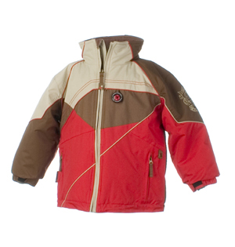
Analysis: Sport Obermeyer
How many jackets should Wally order?
OS, Hk
SO, US
Retailers
Orders
Demand
Newsvendor Vs. Sport Obermeyer
  Many products
  Order 2 times
  Minimum order quantities
  Lead-time
  Supply chain issues
What does SO know at the time of ordering?
  First order:
  Second order:
Nothing
80% of total demand

Slide 8
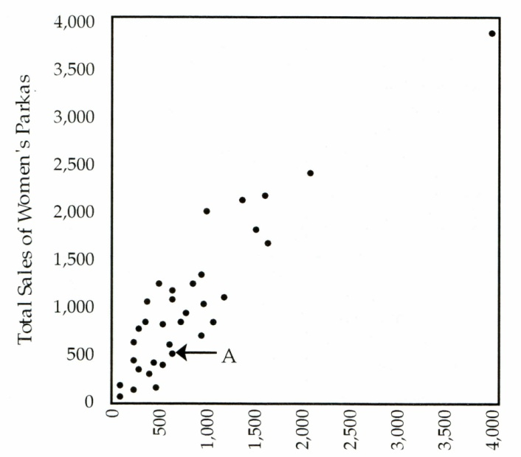
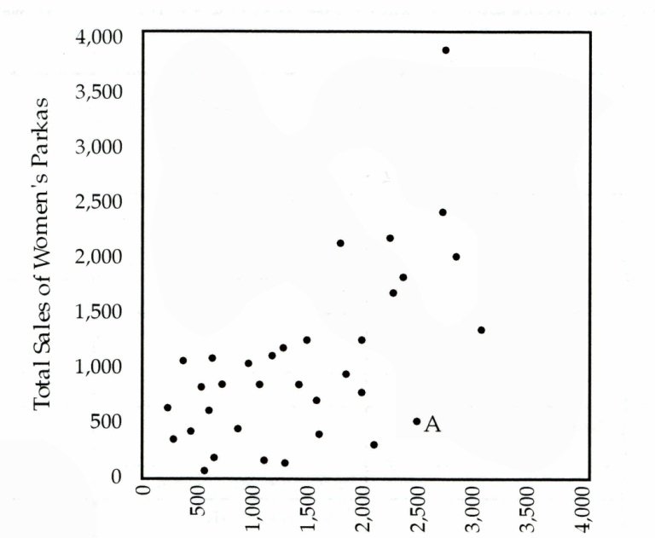
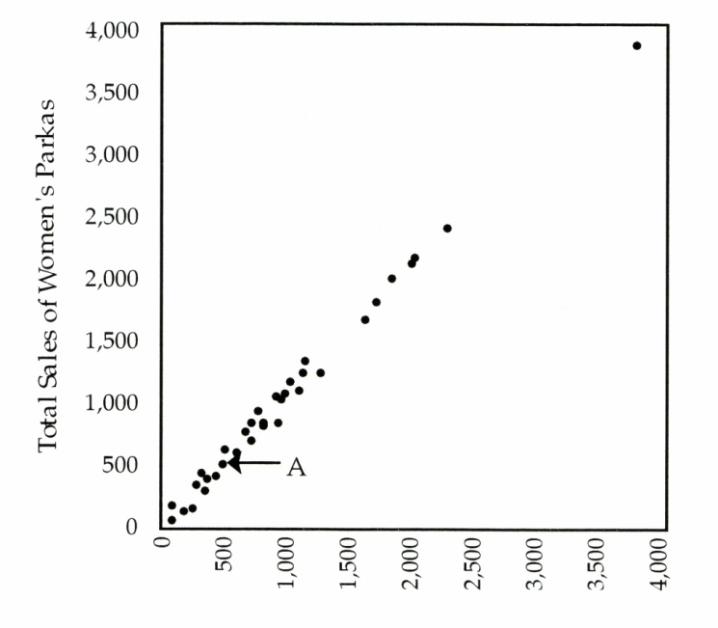
Exhibit 5

Slide 9
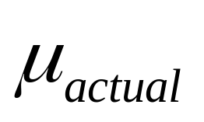
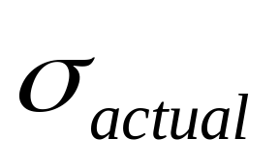
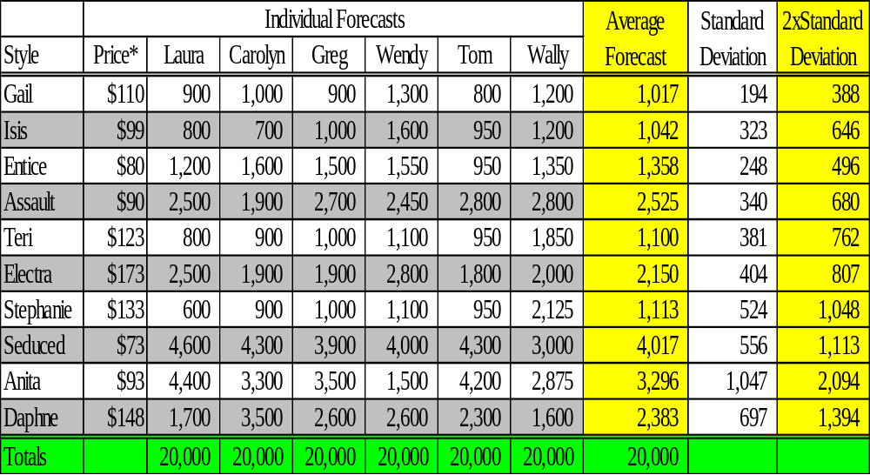
Buying Committee Forecasts
* Obermeyer's wholesale price

Slide 10
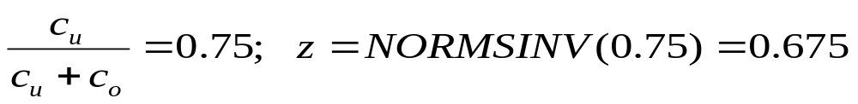

How Many Jackets Should Wally Order?
Simplest case: take Exhibit 10, and assume
  single order, no capacity constraints, no min. order quantities
Solution procedure: the “newsvendor” model
  c_{u} = “understock” cost = 24% (lost profit margin)
  c_{o} = “overstock” cost = 8% (cost of markdown)
Optimal order quantity:
Example: “Gail”: order qty: 1017 + 0.675*388 = 1279

Slide 11
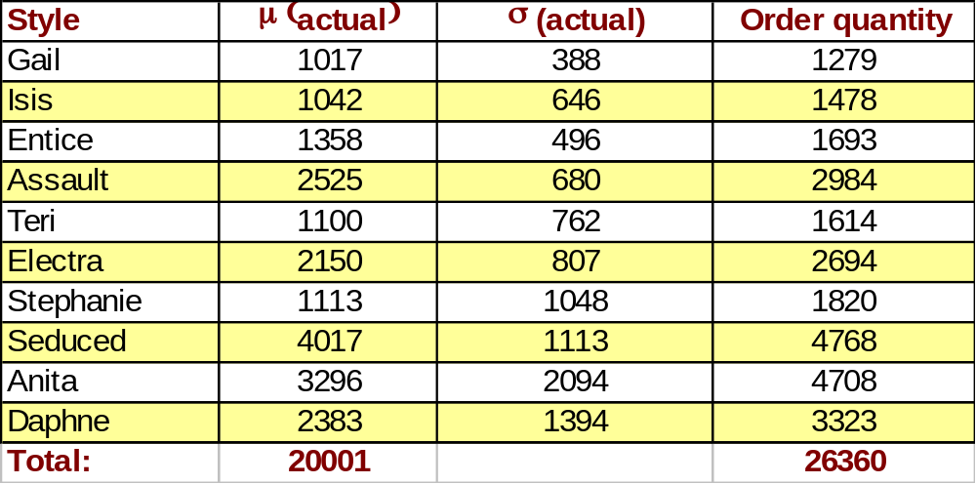
Order Quantities: Simplest Case
What’s the problem with this?

Slide 12
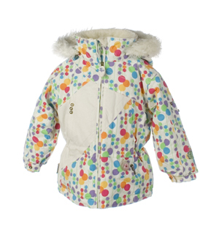
What to Produce in the First Period?
Total capacity: 20000
Need to produce 10000 units in 1st period
Issues
  What is the primary risk in period 1?
  Product Price
  Demand uncertainty
  Expected demand
Stain Removal Tip
CHEWING GUM - Hold a piece of ice against area until gum hardens, then scrape away

Slide 13
Capacity Constraint
Style | μ | σ | Q∗
Gail | 1017 | 388 | 1279
Isis | 1042 | 646 | 1478
Entice | 1358 | 496 | 1693
Assault | 2525 | 680 | 2984
Teri | 1100 | 762 | 1614
Electra | 2150 | 807 | 2694
Stephanie | 1113 | 1048 | 1820
Seduced | 4017 | 1113 | 4768
Anita | 3296 | 2094 | 4708
Daphne | 2383 | 1394 | 3323
Total available: 20,000.
Produce 10,000 in 1st period
Should multiply all Q* by (10,000/26,361)?
Not quite..
Need a new approach!
Total |  |  | 26361

Slide 14
Capacity Constraint (cont.)
Total capacity: 20,000
Need to produce 10,000 units in 1st period
How to solve this?
  Notice that c_{u} = 24%, and c_{o} = 8% for every style (or product).
  Hence the critical ratio and the z-value is same for all styles
  We know: μ, σ for every style, total capacity (= 10,000)
  Find new “z” such that we use only 10,000 unit capacity

Slide 15
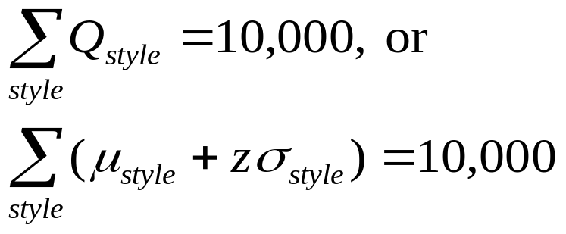
Capacity Constraint (cont.)
Produce 10,000
Style | μ | σ | Q∗
Gail | 1017 | 388 | 1279
Isis | 1042 | 646 | 1478
Entice | 1358 | 496 | 1693
Assault | 2525 | 680 | 2984
Teri | 1100 | 762 | 1614
Electra | 2150 | 807 | 2694
Stephanie | 1113 | 1048 | 1820
Seduced | 4017 | 1113 | 4768
Anita | 3296 | 2094 | 4708
Daphne | 2383 | 1394 | 3323
We need new z such that
Therefore,
20001 + z*9428 = 10000
Total | 20,001 | 9428 | 26361
Solve, z = -1.06
Find new Q*

Slide 16
Capacity Constraint (cont.)
Style | μ | σ | Q∗ | Q* (capacity constrained)
Gail | 1017 | 388 | 1279 | 1017+(-1.06)*388 = 606
Isis | 1042 | 646 | 1478 | 1042+(-1.06)*646 = 357
Entice | 1358 | 496 | 1693 | 832
Assault | 2525 | 680 | 2984 | 1804
Teri | 1100 | 762 | 1614 | 292
Electra | 2150 | 807 | 2694 | 1295
Stephanie | 1113 | 1048 | 1820 | 2
Seduced | 4017 | 1113 | 4768 | 2837
Anita | 3296 | 2094 | 4708 | 1076
Daphne | 2383 | 1394 | 3323 | 905
Total | 20,001 | 9428 | 26361 | 10,007
From last slide, z = -1.06. Find new Q*

Slide 17
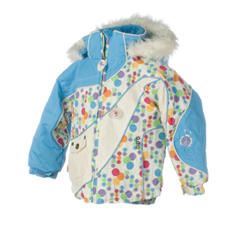
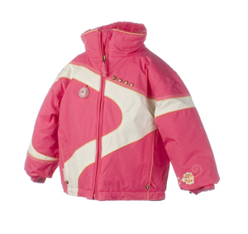
How to Deal with Minimum
Order Quantities ?
Find “safe” styles to order in first period
  Expected demand > 2 x min order qty:
  Expected demand < min order qty
  min order qty < Expected demand < 2 x min order qty
Use Mathematical model
Risk-based Production Scheduling
Tip; ALCOHOL - Dilute area with cool water, and then go home!

Slide 18
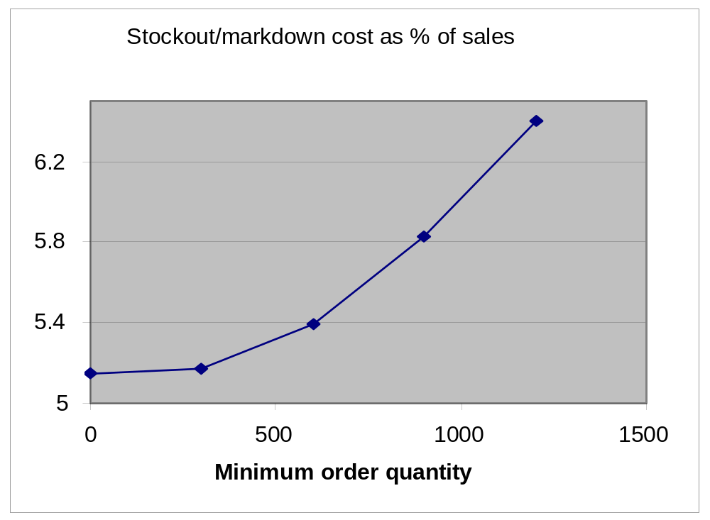
Reducing Minimum Order Quantities

Slide 19
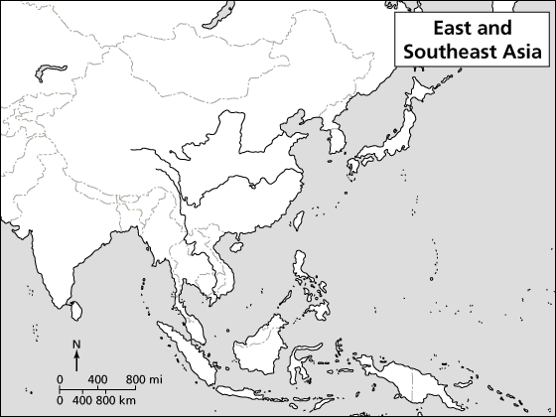
The Global Supply Chain
Germany-Snaps
Korea-Fabric/insulation
Japan-Fabric/Zipper
Swiss-Fabric
USA-Fabric
Taiwan-Fabric/Insulation
Italy-Snaps
Australia-Fabric

Slide 20
Coordination in The Global
Supply Chain
Issues
  Demand variability
  Component sourcing
  Lead time
  Taxes, tariffs
  Trade barriers, quota, etc.

Slide 21
Hong Kong VS. China
 | Hong Kong | China
Line Configuration | 10-12 people/line | 40 people/line
Training | Cross-trained 50% faster | Trained for single operation only
Repair Rate | 1-2% | 10%
Minimum Order Quantity | 600 units | 1200 units
Cost | $60.08 (landed) $3.84/hr (labor) | $51.92 $0.16/hr

Slide 22
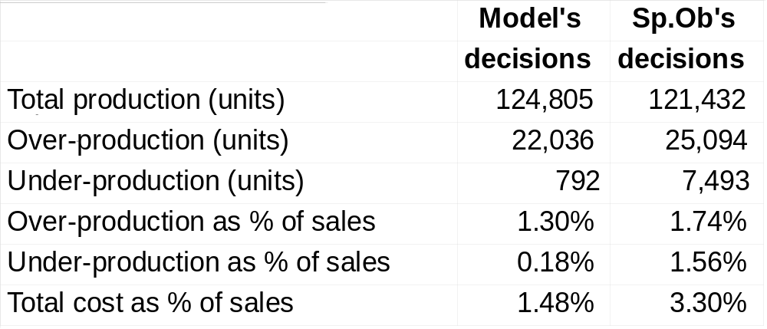
Results at Sport Obermeyer

Slide 23
Lessons Learned
Blend statistics with expert predictions!
The big picture
  How forecasting relates to production planning
  Role of lead-time in SCM
  How forecasting relates to SCM
Strong analytical techniques are useful
Tip; BUTTER - Pre-treat & follow regular laundering instructions for washables.

Slide 24
A quick demo of the newsvendor calculations spreadsheet ..

Slide 25
Lecture Outline
Case: Sport Obermeyer
Classifying Inventory Models
Inventory Models: The Details
Summary

Slide 26
Inventory policy
at a location
(e.g. at a DC)
Supplier
ASIC
US DC
Retailer
Customer
Supplier
PC
Board
FAT
Euro DC
Retailer
Customer
Supplier
Subassembly
Far East DC
Supplier
Retailer
Customer
You are the manger of
this facility. What is your
optimal inventory policy?
Need right inventory
model that tells you
when & how much to
order
What is the
right model?
Inventory Modeling
Approaches
Finding total
inventory in a
supply Chain
Supplier
Manufacturer
Distributor
Retailer
Customers
What is the total
inventory in this SC?
Depends on inventory policies at stocking
locations. Total SC inventory = CS + SS + PS

Slide 27

What is the Right Model?
Classifying Inventory Models
Inventory Models
Repeat Purchase
One-shot
Newsvendor
“Fashion” type
Random demand
Fixed Order Qty
(continuous review)
Fixed Time Period
(periodic review)
(Q, R) Model
EOQ w/ SS
Base stock
policy
(s, S)
policy
EOQ
Fixed demand
Fixed cost to order
Random demand
Fixed cost to order
Random demand
No fixed cost
Random demand
Fixed cost to order

Slide 28
Which Model/Approach?
Look for clues…
fashion/new product
Food/grocery items
e-procurement
No SD of demand
Need total inventory
Impact of replacing say
5 DCs with one
Newsvendor
Repeat purchase
No fixed cost (base stock)
EOQ
Total SC Inv (PS, SS, CS)
Total SC Inv (PS, SS, CS)

Slide 29
Lecture Outline
Case: Sport Obermeyer
Classifying Inventory Models
Inventory Models: The Details
Summary

Slide 30

Notation & Definitions
Demand (D)
  Customer requirement (daily, weekly, etc.)
  Can be fixed (SD = 0) or random (normal, mean , SD s )
  Lead time (L)
  Time for replenishment
  Can be fixed or random
Review period (T)
  How often do you review inventory (continuous vs. periodic)
Decision Variables
  Reorder point (R)
    when do you want to order (e.g.: order when you have 50 left)
  Quantity to be ordered (Q)
REMEMBER
We need to express D, L, T in
identical time units (e.g., all in days)
Notes:
7

Slide 31
What is the Right Model?
Classifying Inventory Models
Inventory Models
Repeat Purchase
One-shot
Newsvendor
“Fashion” type
Random demand
Fixed Order Qty
(continuous review)
Fixed Time Period
(periodic review)
(Q, R) Model
EOQ w/ SS
Base stock
policy
(s, S)
policy
EOQ
Fixed demand
Fixed cost to order
Random demand
Fixed cost to order
Random demand
No fixed cost
Random demand
Fixed cost to order

Slide 32
Economic Order Quantity (EOQ) Model
Simplest & most widely used model
Assumptions
  Continuous review policy is followed
  Demand is fixed and known
  Demand and costs don’t change over time
  Fixed (or set up) cost of placing order
  Minimize annual cost
It is also called lot (or batch) sizing model
  Why?
Decision Variables
1. Optimal batch size
(or, how much to order)
2. Optimal reorder point
(or, how much to order)
Notes:
13

Slide 33
EOQ Model: Reorder Point Behavior
Inventory
on hand
Q
Q
Q
R
L
L
Time
R = Reorder point
Q = Economic order quantity
L = Lead time
We want to find optimal Q
Notes:
10

Slide 34
Cost Minimization Goal
By adding the purchasing, holding, and ordering costs, we determine the total cost curve, which is used to find the Q*, the optimal order point that minimizes total costs.
Total Cost
C
O
S
T
Holding
Costs
Annual Cost of
Items (DC)
Ordering Costs
Q*
Order Quantity (Q)
Notes:
11

Slide 35
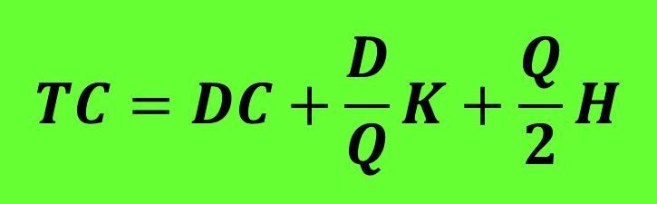
The EOQ Model Formula
Annual
Purchase
Cost
Annual
Ordering
Cost
Annual
Holding
Cost
Total Annual Cost (TC) =
+
+
TC = Total annual cost
D = Annual demand
C = Purchasing cost per unit
Q = Order quantity
K = Fixed (or setup) cost of placing an order
R = Reorder point
L = Lead time
H = Annual holding cost per unit of inventory
$$TC=DC+\frac{D}{Q}K+\frac{Q}{2}H$$
Notes:
12

Slide 36
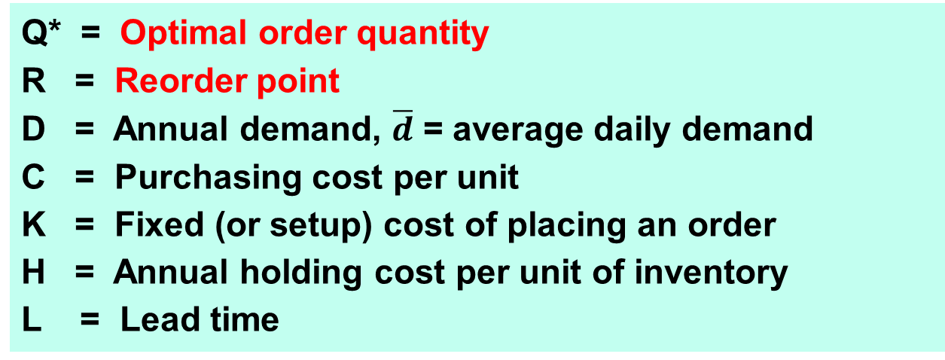

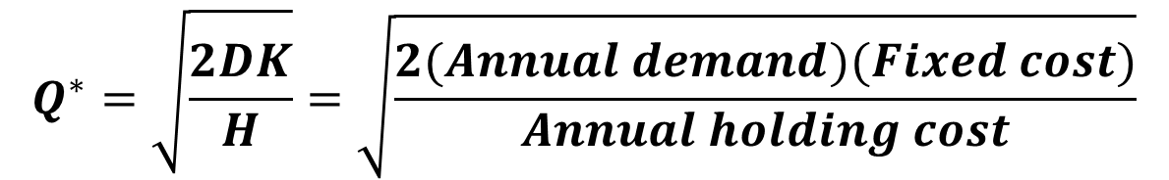
The EOQ Formula
Q* = Optimal order quantity
R = Reorder point
D = Annual demand, $\overline{d}$ = average daily demand
C = Purchasing cost per unit
K = Fixed (or setup) cost of placing an order
H = Annual holding cost per unit of inventory
L = Lead time
$$Q^{∗}=\sqrt{\frac{2DK}{H}}=\sqrt{\frac{2(Annual demand)(Fixed cost)}{Annual holding cost}}$$
How much to order
(optimal order quantity)
:
How much to order
(reorder point)
:
$$R=\overline{d}L$$
Notes:
13

Slide 37
EOQ Example
Given the information below, what are the EOQ and reorder point?
Annual Demand = 1,000 units
Days per year considered in avg. daily demand = 365
Cost to place an order = $10
Holding cost per unit per year = $2.50
Lead time = 7 days
Cost per unit = $15
Notes:
14

Slide 38
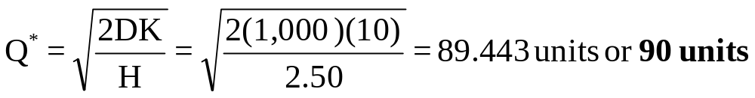
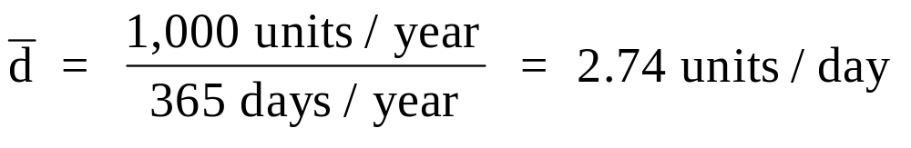
EOQ Example Solution
In summary, you place an optimal order of 90 units. In the course of using the units to meet demand, when you only have 20 units left, place the next order of 90 units.
We need to express D, L, T in
identical time units (e.g., all in days)
Notes:
15

Slide 39
EOQ Example:
Can We find the Total Cost?
D = 1000, K = $10, H = $2.5, c = $15, Q* = 90
Annual
Purchase
Cost
Annual
Ordering
Cost
Annual
Holding
Cost
Total Annual Cost =
+
+
Purchase cost = D*C = 1000*$15 = $15,000 / year
Ordering cost = (D/Q)*K = (1000/90)*$10 = $111.11 / year
Holding cost = (Q/2)*H = (90/2)*$2.5 = $112.50 / year
TOTAL cost = $15,223.61 / year
Average Inventory during the year = Q/2 = 90/2 = 45
Notes:
15

Slide 40
EOQ: Is this Useful in Practice?
Applicable in B2B (purchasing)
TC
Total cost curve is very flat around
the region of optimality
Simple, easy to understand
T*
Random demand: add safety stock
(you will see this next)
Notes:
15

Slide 41
What is the Right Model?
Classifying Inventory Models
Inventory Models
Repeat Purchase
One-shot
Newsvendor
“Fashion” type
Random demand
Fixed Order Qty
(continuous review)
Fixed Time Period
(periodic review)
(Q, R) Model
EOQ w/ SS
Base stock
policy
(s, S)
policy
EOQ
Fixed demand
Fixed cost to order
Random demand
Fixed cost to order
Random demand
No fixed cost
Random demand
Fixed cost to order

Slide 42
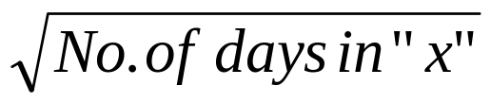
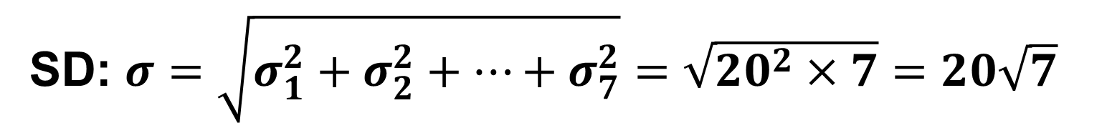
Adding Normal Distributions
The daily demand for iPads at the local Best Buy store is N(50, 20). The lead-time (L) for replenishment is one week. What is the demand during lead time?
Weekly demand is normal with:
Mean: $μ=μ_{1}+μ_{2}$+…+$μ_{7}=50+50+…+50=350$
SD: $σ=\sqrt{σ_{1}^{2}+σ_{2}^{2}+…+σ_{7}^{2}}=\sqrt{{20}^{2}×7}=20\sqrt{7}$
Mean of demand during “x” days = Daily mean * x
SD of demand during “x” days = Daily SD *

Slide 43


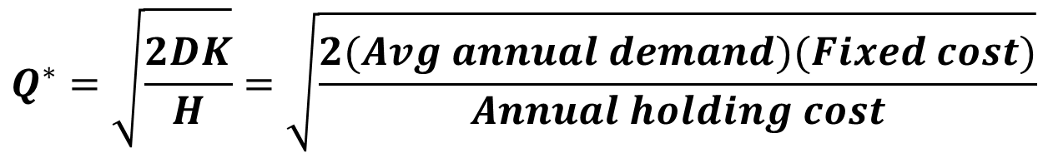
(Q, R) Model
Random demand (normal)
Need Safety stock, which depends on service level desired
$$Q^{∗}=\sqrt{\frac{2DK}{H}}=\sqrt{\frac{2(Avg annual demand)(Fixed cost)}{Annual holding cost}}$$
How much to order
(optimal order quantity)
:
When to order
(reorder point)
:
$$R=\overline{d}L+zσ_{L}$$
Safety Stock (SS) = z σ _{L}
R = Reorder point
= Average daily demand, D = Average annual demand
L = Lead-time in days
z = Number of standard deviations for a specific service level
σ_{L} = Standard deviation of demand during the lead-time
We need to express
D, L, T in identical
time units

Slide 44
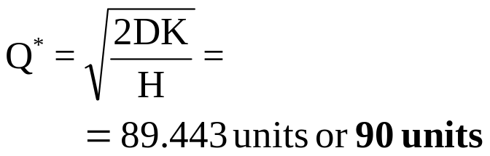
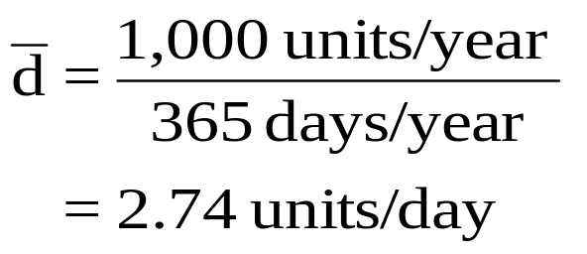
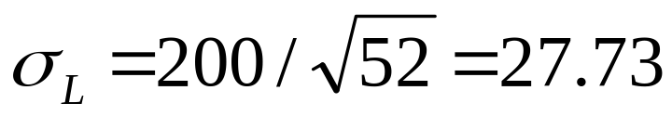
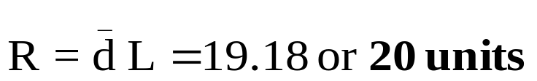
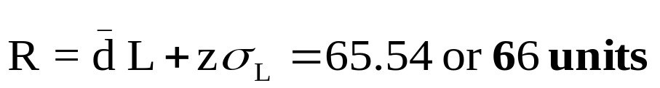
EOQ and (Q, R) Examples
C = $15, H = $2.5, K = $10.00, L = 7 days.
Annual demand: 1000 (fixed) OR D ~ N(1000, 200) with 95% SL desired
EOQ Solution (D fixed)
(Q, R) Solution (D random)
z = NORMSINV (0.95) = 1.65

Slide 45
What is the Right Model?
Classifying Inventory Models
Inventory Models
Repeat Purchase
One-shot
Newsvendor
“Fashion” type
Random demand
Fixed Order Qty
(continuous review)
Fixed Time Period
(periodic review)
(Q, R) Model
EOQ w/ SS
Base stock
policy
(s, S)
policy
EOQ
Fixed demand
Fixed cost to order
Random demand
Fixed cost to order
Random demand
No fixed cost
Random demand
Fixed cost to order

Slide 46
Outline: Base Stock Policy
(also called order up-to policy)
Introduction
Base stock for SL requirements
Other performance measures
Managerial Insights

Slide 47
The Definitions: Order up-to Policy
On-order inventory / pipeline inventory = the number of units that have been ordered but have not been received.
On-hand inventory = the number of units physically in hand and ready to serve demand.
Backorder = the amount of demand yet to be satisfied:
  All backordered demand is eventually filled (no lost sales)
Inventory position = On-order inventory + On-hand inventory – Backorders
Inventory level = On-hand inventory – Backorders
Order up-to level, s
  the maximum inventory position we allow, also called the base stock level.

Slide 48
Base Stock Model or
Order up-to Model
Assumptions
  review at fixed and regular time intervals of T (called one period)
  random demand (D), no setup cost of ordering, fixed lead-time (L)
  objective: minimize total cost, meet SL requirements
Policy
  review at fixed intervals
  whenever inventory position (IP) is blow s, order up to s
The units of D, L, T are in days, weeks, etc.
Length of one period = T days, or T weeks, etc.
Notes:
18

Slide 49
Base Stock Policy or Order up-to Policy
Inventory position (IP) goes up
on-hand Inv. goes up, no change in IP
Order
(current
period)
Get Supply
(from an earlier
period)
On-hand inventory @ start and end
Demand
Time
Previous
period
(7 days)
Next
period
(7 days)
7 days
Current period (7 days)
Review
inventory
Review
inventory
Notes:
18

Slide 50
Order up-to Policy
s
Inventory
position
Q₁
Q₂
Q₃
On-hand inventory
Order
received
Order
placed
B
L
L
L
Time
A
Order
placed
T
T
Protection interval

Slide 51
Base Stock Policy or Order up-to Policy
The units of time (e.g., day) vs. the period
Example: demand is normal with mean (μ) = 50 per day, SD (σ) = 15 per day
Lead-time (L) = 25 days, review period (T) = 10 days.
Assigned Reading
Our Approach (this PPT file)
One period = 10 days (by definition)
One period = T days = 10 days
Units for calculations: period
  T = 1, L= (25/10) = 2.5 periods
  μ = 50x10 = 500 per period
  σ = 15*SQRT(10) = 47.4 per period
Units for calculation: days
  T = 10 days, L= 25 days
  μ = 50 per day
  σ = 15 per day
Calculations based on (L+1) periods
Calculations based on (L+T) days
Notes:
18

Slide 52
Outline: Base Stock Policy
(also called order up-to policy)
Introduction
Base stock for SL requirements
Other performance measures
Managerial Insights

Slide 53
Choose s to meet SL requirements

Slide 54
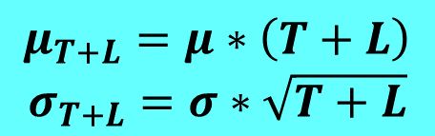

Base Stock Policy
s (base stock or order up to level) = Average demand during (T+L) + Safety stock
Q (quantity to order) in any period = s – Inventory position (I)
$$μ_{T+L}=μ∗\left(T+L\right)$$
$$σ_{T+L}=σ∗\sqrt{T+L}$$
$$s= μ_{T+L}+zσ_{T+L}$$
Where:
T = review period in days
L = lead-time in days
μ_{T+L} = mean/average demand over lead-time & review period (i.e., T+L days)
σ _{T+L} = SD of demand over lead-time & review period (i.e., T+L days)
μ ,σ = mean and SD of daily demand
Z = no. of standard deviations for a given service level
Safety Stock (SS) = z σ _{T+L}
Notes:
18

Slide 55
Base Stock Policy: Example
Given the information below,
  What is the base stock level?
  How many units should be ordered?
Average daily demand for a product is 20 units. The review period is 30 days, and lead time is 10 days. Management has set a policy of 96 percent service level (in-stock probability). At the beginning of the
review period there are 200 units in inventory. The daily demand standard deviation is 4 units.
μ = 20/day, σ = 4/day, L = 10 days, T = 30 days, SL = 96%, I = 200
Notes:
21

Slide 56
Solution
μ = 20/day, σ = 4/day, L = 10 days, T = 30 days, SL = 96%, I =200
Base stock = $s= μ_{T+L}+zσ_{T+L}$
$$μ_{T+L}=μ×\left(T+L\right)=20×\left(30+10\right)=800$$
$$σ_{T+L}=σ×\sqrt{T+L}=4×\sqrt{(30+10)}=25.298$$
For 96% service level, z = NORMSINV(0.96) = 1.75
$$s= μ_{T+L}+zσ_{T+L}=800+1.75×25.298=844.27 or 845$$
Quantity to order: $Q=s−I=845−200=645$
Notes:
22

Slide 57
Outline: Base Stock Policy
(also called order up-to policy)
Introduction
Base stock for SL requirements
Other performance measures
Managerial Insights

Slide 58
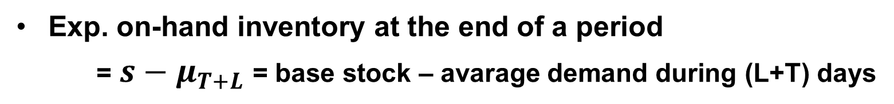
Stock-out probability, on-order, and on-hand inventories
Performance Measures
Stockout probability is the chance that at least one unit is backordered in a period:
Stockout probability = Pr{demand over (L+T) days > s}
= 1- Pr{demand over (L+T) days ≤ s}
In-stock probability = 1 – stock-out probability
Exp. on-order inventory = average demand per day (μ) × lead-time (L) in days
  Note: the formula should have L days, not L+T days (this is Little’s Law)
Exp. on-hand inventory at the end of a period
= $s−μ_{T+L}$ = base stock – avarage demand during (L+T) days

Slide 59
Outline: Base Stock Policy
(also called order up-to policy)
Introduction
Base stock for SL requirements
Other performance measures
Managerial Insights

Slide 60
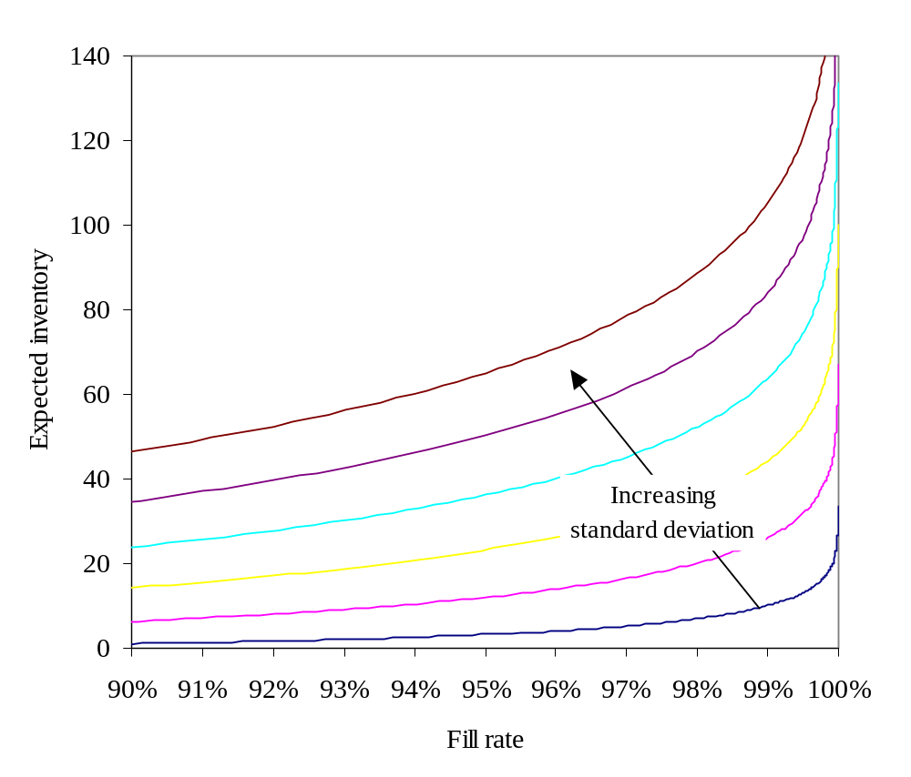
Better service requires more inventory at an increasing rate
More inventory is needed as demand uncertainty increases for any fixed fill rate.
The required inventory is more sensitive to the fill rate level as demand uncertainty increases
Service Level
The tradeoff between inventory and SL with normally distributed demand and a mean of 100 over (L+T) days. The curves differ in the standard deviation of demand over (L+T) days: 60,50,40,30,20,10 from top to bottom.

Slide 61
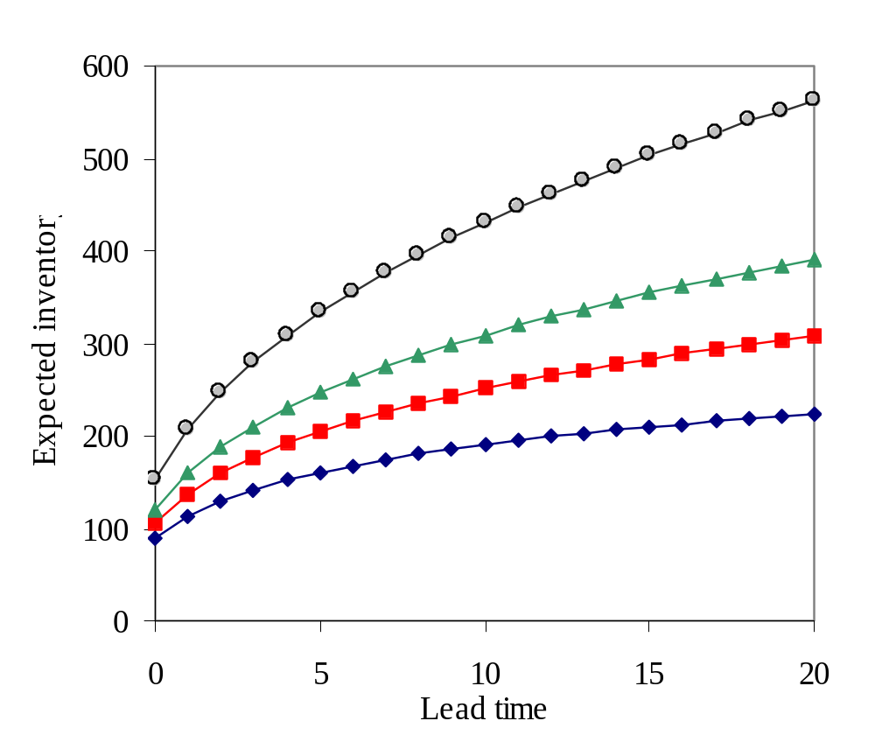
Shorten lead times, you will reduce inventory
Reducing the lead time reduces expected inventory, especially as the target fill rate increases
The impact of lead time on expected inventory for four fill rate targets, 99.9%, 99.5%, 99.0% and 98%, top curve to bottom curve respectively. Demand in one period is normally distributed with mean 100 and standard deviation 60.

Slide 62
Summary: Order up-to Model
The order up-to model is appropriate for products with random demand but many replenishment opportunities.
Expected inventory and service are controlled via the order up-to level:
  The higher the order up-to level the greater the expected inventory and the better the service.
The key factors that determine the amount of inventory needed are…
  The length of the replenishment lead time.
  The desired service level (SL or in-stock probability).
  Demand uncertainty.
When inventory obsolescence is not an issue, the optimal service level is generally quite high.

Slide 63
Check Point …
Inventory Models
Repeat Purchase
One-shot
Newsvendor
“Fashion” type
Random demand
Fixed Order Qty
(continuous review)
Fixed Time Period
(periodic review)
(Q, R) Model
EOQ w/ SS
Base stock
policy
(s, S)
policy
EOQ
Fixed demand
Fixed cost to order
Random demand
Fixed cost to order
Random demand
No fixed cost
Random demand
Fixed cost to order

Slide 64
In-class exercise …..
703 Grocers Inc.

Slide 65
Lecture Outline
Case: Sport Obermeyer
Classifying Inventory Models
Inventory Models: The Details
Summary

Slide 66
Summary & Key Takeaways
Inventory Management
    Different models and approaches
    What model is applicable when

Slide 67
Next Class:
Inventory Management - IIII
Risk Pooling & Warehousing
Read
  eBook, p. 40-48
  Review all inventory management notes from our class
HW 2 due at the beginning of class
What is a good start date for take-home final exam?
  You will have one week to work on it
  Check your schedules, will ask next week

